Slide 1
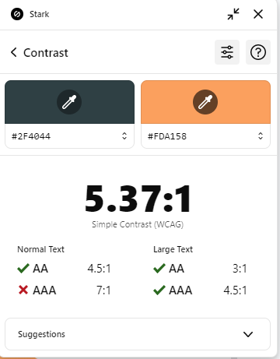
Summer Training
Session 4
MVC 2
Mahmoud Ahmed ☺

Slide 2
Table of contents
01
02
03
04
05
06
Model Binding
Generate HTML Markup
Layout
Validations
Server-Side VS Client-Side
Custom Validations

Slide 3
01
Model Binding

Slide 4
What is Model Binding?
Model Binding in ASP.NET is the process of automatically mapping HTTP request data to action method parameters in your controller.
There are 3 main to sent data to the server:
Route Data.
Query String.
Request Body.

Slide 5
Ways Data is Sent to the Server
Route Data
Query String
Request Body
Data that's part of the URL path itself.
Data passed as key-value pairs after a ? In the URL
Data sent in the body of the HTTP request, usually in:
POST
PUT
PATCH
Example:
/product/get/2
Example:
/product/get?id=2&name=mohamed

Slide 6
Differnce Between Methods GET vs POST
 | GET | POST
Use | Read Data | Insert Data
Body | Doesn’t have a Body | Has a Body
Send Data | Use the URL (Route Data or Query String) | Use the Request Body

Slide 7
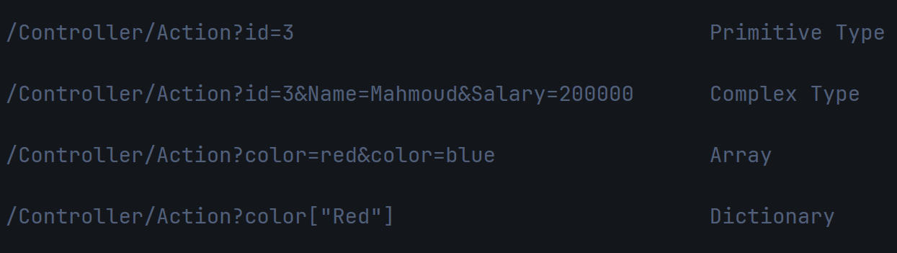
How to Send Different Types of Data in Query String?

Slide 8
Hands-On #1
Add new actions to your “SessionDemo” project that open form to add new user and submit the form.

Slide 9
02
Generate HTML Markup

Slide 10

Ways to Generate HTML Markup
1-Pure HTML
Before HTML Helpers, we used to write raw HTML and insert C# Code inside it.

Slide 11
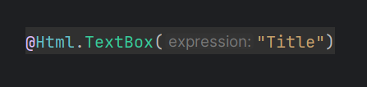

Ways to Generate HTML Markup
2-HTML Helper
HTML Helpers are utility methods in ASP.NET MVC that generate HTML elements dynamically inside a View instead of writing static HTML manually.
Loosely Typed
Strongly Typed

Slide 12

Ways to Generate HTML Markup
3-Tag Helper
Newer feature (ASP.NET Core) — special HTML-like attributes that the Razor engine processes to generate HTML with server-side logic.

Slide 13
03
Layout

Slide 14
What is Layout?
Microsoft provides a default shared layout that acts as a template for multiple views. It contains a special object called @RenderBody, which is replaced by the actual View when rendered.

Slide 15
RenderBody vs RenderSection
1-RenderBody
The View Replaces @RenderBody inside the Layout
Required in a Layout
2-RenderSection
A Layout can have multiple @RenderSection placeholders
These allow specific sections in Views to be inserted into the Layout.
It takes a section name and a boolean (optional, default = true means required).

Slide 16
04
Validations

Slide 17
What is Validation?
Validations are rules you set to make sure the data coming into your application is correct, complete, and in the format you expect before you save or process it.
Types of Validations
Server-Side.
Client-Side.
Constraints.

Slide 18
What is [ValidateAntiForgeryToken] ?
[ValidateAntiForgeryToken] is an attribute used in ASP.NET MVC & ASP.NET Core to prevent Cross-Site Request Forgery (CSRF) attacks.
CSRF (Cross-Site Request Forgery attacks): It’s when a malicious site tricks a logged-in user into submitting a request (like a form) to another site without their permission.

Slide 19
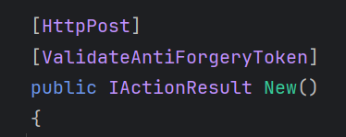
How to Use [ValidteAntiForgeryToken]
1-Secure Controller Action
In your controller, apply the [ValidateAntiForgeryToken] attribute to the POST action to enforce CSRF protection.
2-Secure Razor View (Form)
To ensure the token is included in the form, you must use either Tag Helpers (ASP.NET Core) or HtmlHelpers (ASP.NET MVC & Core).

Slide 20
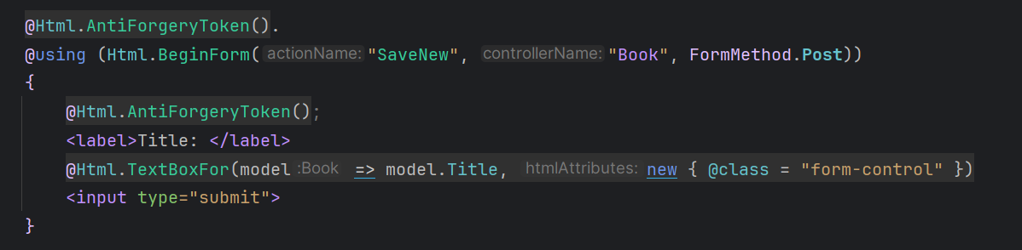
Secure Razor View (Form)
1-Using HTML Helpers
If you're using Html.BeginForm(), you must manually add
Without @Html.AntiForgeryToken(), the request will fail with HTTP 403 Forbidden.

Slide 21
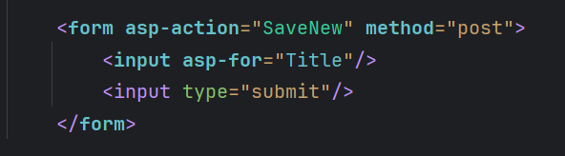
Secure Razor View (Form)
2-Using Tag Helpers
ASP.NET Core automatically adds the CSRF token for Tag Helper, so you don’t need to manually include @Html.AntiForgeryToken().
The hidden input is automatically generated:

Slide 22
How it Works?
When the form is generated, @Html.AntiForgeryToken() inserts a hidden input field with a CSRF token: Client-Side.
When the form is submitted, the browser sends this token along with the request.
ASP.NET checks the token in the [ValidateAntiForgeryToken] attribute.

Slide 23
Validation is Done at 3 Layers:
Has validation rules (Data Annotations, custom attributes).
Shows validation messages based on ModelState and uses client-side scripts.
Model
View
Controller
Checks ModelState.IsValid and decides whether to proceed or return errors.

Slide 24
What is ModelState?
In ASP.NET MVC, ModelState is an object that stores the state of model binding and validation during a request.
Key | Value | Error Count
Id | [Required] | 0
Title | [Title] [MaxLength(5)] | 1
Total Count = 1, IsValid = false

Slide 25
05
Server-Side VS Client-Side

Slide 26
1-Server-Side Validation
When it Runs:
After the form is submitted and data reaches the server.
How it works in ASP.NET MVC:
The controller action checks the ModelState.
ModelState is automatically populated based on model binding + data annotations.
If ModelState.IsValid is false, you return the same View with errors.

Slide 27
2-Client-Side Validation (Browser)
When it Runs:
Directly in the user’s browser, before sending data to the server.
How it works in ASP.NET MVC:
ASP.NET MVC uses jQuery Unobtrusive Validation + HTML5 attributes.
When you add data annotations in your Model, MVC automatically generates the corresponding data-val HTML attributes in the View.
You need to include the required JavaScript libraries which read those attributes and validate instantly.

Slide 28
Hands-On #2
1-Add validations in model.
2-Check ModelState in controller.
Show errors in view.

Slide 29
06
Custom Validations

Slide 30
How to Make Custom Validations?
1-Making my Own Attribute
If I want to create a unique attribute for a name, I need to create a new model (class) and name it with 'Attribute' at the end.
2-Making Remote Validation
[Remote] is an attribute used for client-side validation that makes an AJAX call to the server to validate a field without submitting the entire form.
Note: Remote Validation is server-side validation, but initiated from the client before form submission.

Slide 31
Thank You Glb <3

